Slide 1
Chapter 3 Understanding Learning and Memory
ISC

Slide 2
I. Flaws in Human Memory
I.1. Transience
I.2. Absent-mindedness
I.3. Blocking
I.4. Misattribution
I.5. Suggestibility
I.6. Bias
I.7. Persistence

Slide 3


I.1. Transience
The situation when individuals fail to remember a fact or idea
It is a weakening or loss of memory over time

Slide 4

I.2. Absent-mindedness
The breakdown between attention and memory

Slide 5

I.3. Blocking
The unsuccessful search for info that we may be desperately trying to retrieve
Gee, what’s her name? I can’t remember it.

Slide 6
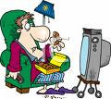
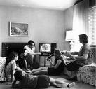
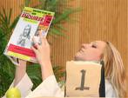
I.4. Misattribution
Assigning a memory to the wrong source
Incorrectly remembering that someone told you something that you actually read about in a newspaper

Slide 7
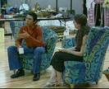
I.5. Suggestibility
Memories that are implanted because of leading questions, comments, or suggestion
Didn’t you remember the time you …..?

Slide 8


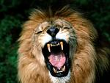
I.6. Bias
The editing of changing of previous experiences based on what we now feel rather than what happened in the past
“Thương thì củ ấu cũng tròn, ghét thì bồ hòn cũng méo”
She’s a devil

Slide 9
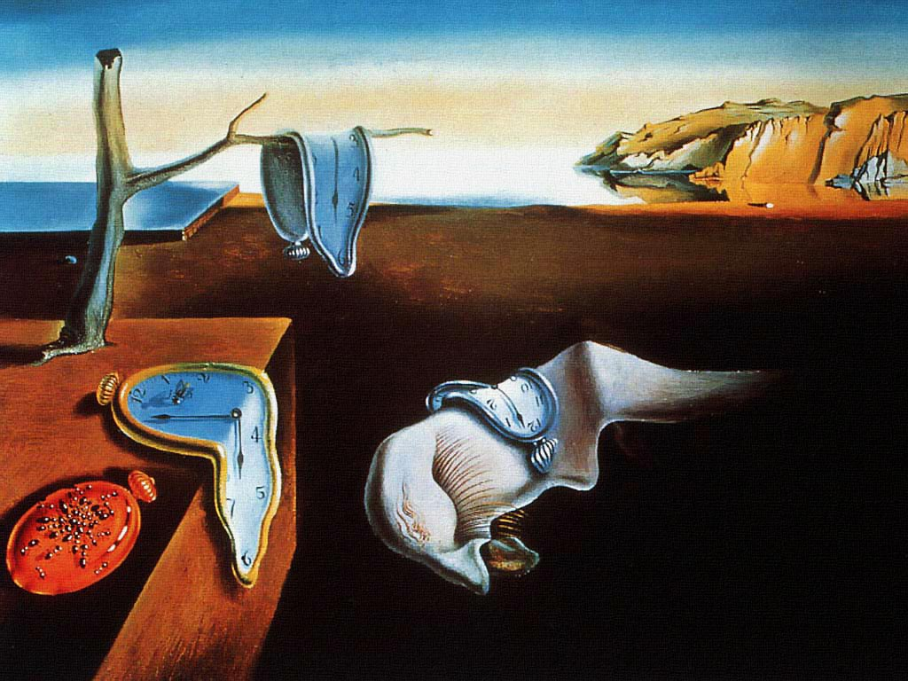
I.7. Persistence
Remembering what we would prefer to omit from our memory

Slide 10
II. Information-Processing System and Learning
Rehearsal
elaboration
Attention
organizational
Storage
input
Short-term
Sensory store
Working
memory
Long-term
memory
Retrieval
Memory loss
Memory loss

Slide 11

III. Difference Between Rote and Meaningful Learning
In rote learning, the student learns through repetition without trying to make any sense of the material
In meaningful learning, the student attempts to make sense of the info so that it will be stored in long-term memory and retrieved when it is needed

Slide 12
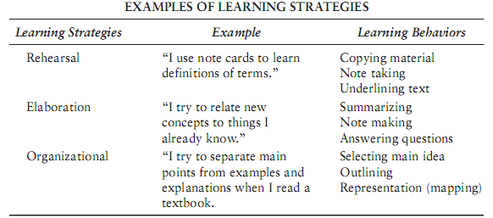
IV. Learning Strategies to Promote Learning and Retention
IV.1. Rehearsal strategies
IV.2. Elaboration strategies
IV.3. Organizational strategies

Slide 13


IV.1. Rehearsal strategies
Practice, practice, practice
Distributed practice among frequent and short periods is more effective than a smaller number of sessions of massed practice

Slide 14
IV.2. Elaboration strategies
Mnemonic
Acronyms:
My very eager mother just served us nine pizzas
Mercury, Venus, Earth, Mars, Jupiter, Saturn, Uranus, Neptune, Pluto
Key- word methods
Learning English new words
Paraphrasing, summarizing, note- taking
Reading
Analogies
A model of memory is like the information selection and storage system you use at home.

Slide 15
IV.3. Organizational strategies
Chunking
F,B,I,M,T,V,U,S,A,H,B,O,CI,A
0983
633
369

Slide 16
IV.3. Organizational strategies
Chunking
FBI MTV USA HBO CIA
098
363
3369

Slide 17
IV.3. Organizational strategies
Categorizing
cô gái, trái tim, con chim, màu tím, ngón tay, cây kèn, màu xanh, đàn piano, người đàn ông, chim đại bàng, đứa trẻ, sáo, màu vàng

Slide 18
IV.3. Organizational strategies
Categorizing
cô gái, đứa trẻ, người đàn ông
trái tim, ngón tay
con chim, chim đại bàng
màu tím, màu xanh, màu vàng
cây kèn, đàn piano, sáo

Slide 19
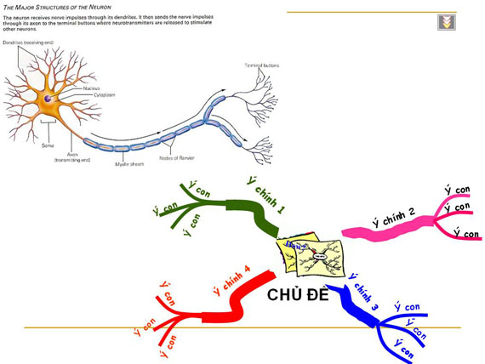
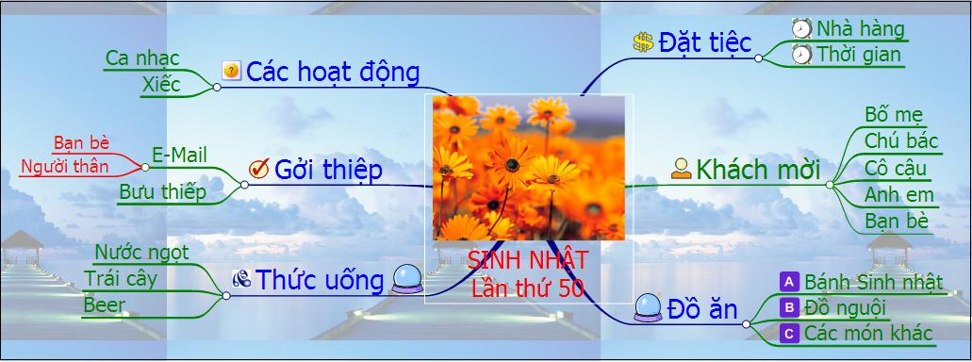

Slide 20
